Slide 1
MIS132 – Lecture 4
程式設計實習課

Slide 2
Outline
Review C (topic this week is important to the other topic, pointer)
How does variable exist in your program?
How does array work in your program?
Learn Python
List
Tuple

Slide 3
Recap what is the variable?
There is a container.
We store goods in the container.
We give the container a name.

Slide 4
Recap what is the variable?
variable
There is a container.
We store goods in the container.
We give the container a name.
the value
variable
variable

Slide 5
Where do we temporary locate containers?

Slide 6
Where do we temporary locate containers?
variables

Slide 7
Different sizes of containers

Slide 8
Different sizes of containers
variables

Slide 9
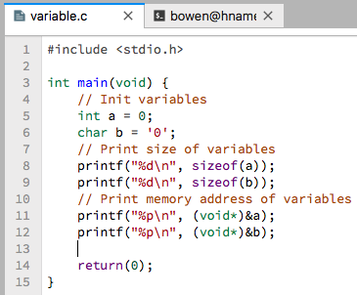
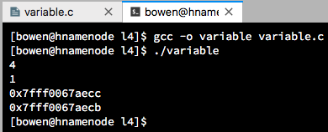
You initialize variables in C, what’s going on?

Slide 10
Variables in your memory
Other contents which we don’t know what they are.
1 byte
4 bytes
… | ‘0’ | 0 | …
Variable name: a
Address: 0x7fff0067aecc
Variable name: b
Address: 0x7fff0067aecb

Slide 11
Array, a list of containers
Here is one container. What if we got lots of same containers?

Slide 12
Array, a list of containers
Here is one container. What if we got lots of same containers?
It will be difficult to give names of them, right?

Slide 13
Array, a list of containers
How do we only name the first container in them?
Start point of solid_container

Slide 14
Array, a list of containers
So, what is the name of the red one?
solid_container[0, 0, 0]

Slide 15
Array, a list of containers
So, what is the name of the blue one?
solid_container[0, 0, 0]
solid_container[1, 0, 0]

Slide 16
Array, a list of containers
So, what is the name of the green one?
solid_container[0, 0, 0]
solid_container[1, 0, 0]
solid_container[1, 2, 0]

Slide 17
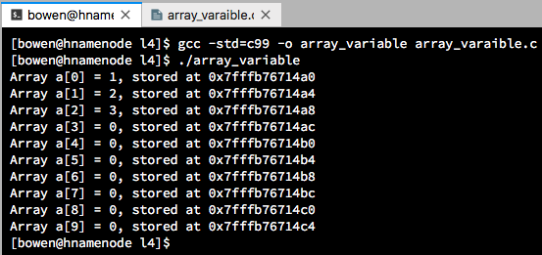
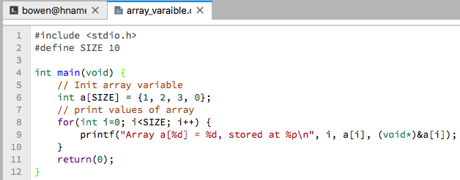
You initialize array variables in C, what’s going on?

Slide 18
Array variable in your memory
Other contents which we don’t know what they are.
Other integers
In array
4 bytes
4 bytes
4 bytes
… | 1 | 2 | … | 0 | …
Index: 1 → a[1]
Address: 0x7fffb76714a4
Index: 9 → a[9]
Address: 0x7fffb76714c4
Start point of array variable
name: a, Index: 0 → a[0]
Address: 0x7fffb76714a0

Slide 19
Of course, we can store a char array as a string
Other contents which we don’t know what they are.
Other characters
In array
1 byte
1 byte
1 byte
… | ‘h’ | ‘e’ | … | ‘\0’ | …
Index: 1 → a[1]
Address: 0x7fffb76714a1
Index: 9 → a[9]
Address: 0x7fffb76714a9
’\0’ is a null character
Start point of array variable
name: a, Index: 0 → a[0]
Address: 0x7fffb76714a0

Slide 20
Of course, we can store a char array as a string
Other contents which we don’t know what they are.
char str1[] = { ‘h’, ‘e’, ‘l’, ‘l’, ‘o’, ‘ ‘,
‘w’, ‘o’, ‘r’, ‘l’, ‘d’, ‘\0’ };
char str2[] = “hello world”;
Basically, str1 and str2 are the same.
Other characters
In array
1 byte
1 byte
1 byte
… | ‘h’ | ‘e’ | … | ‘\0’ | …
Index: 1 → a[1]
Address: 0x7fffb76714a1
Index: 9 → a[9]
Address: 0x7fffb76714a9
’\0’ is a null character
Start point of array variable
name: a, Index: 0 → a[0]
Address: 0x7fffb76714a0

Slide 21
“安西教練！ 我好想打程式” – 三井壽

Slide 22
Practice
Please use an array to store the user input and use three function to make the input become uppercase, lowercase and reversed. You should upload one .c file named with your student ID, for example, B064020099_c04.c.
Output example:
Enter a string: Flower is HANDSOME.
Your input is: Flower is HANDSOME.
The string after uppercased is: FLOWER IS HANDSOME.
The string after lowercased is: flower is handsome.
When we make your input string reversed: .EMOSDNAH si rewolF

